Slide 1
Predicting User Demographics THINKFUL FINAL CAPSTONE SUBBU CHIDAMBARAM

Slide 2
BACKGROUND
Found on Kaggle: https://www.kaggle.com/c/talkingdata-mobile-user-demographics
TalkingData, China’s largest third-party mobile data platform wanted to leverage the behavioral data of its users in order to help its clients better understand and interact with their respective audiences.

Slide 3
WHY CARE ABOUT IDENTIFYING USER DEMOGRAPHICS?
Being able to accurately identify the demographic of one’s audience can help the company better capitalize their experience for their users.
Can accurately identify what sort of market the client has and what sort of method the clients wants to employ in order to gain more users,or retain their current userbase.

Slide 4
GOAL
Find the best model to accurately identify the 12 different groups in the target portion of the data set.
Best will be defined by accuracy and computational time of the model.
Notes:
Moving from research question to some kind of hypothesis -- you want to use logic, theory and prior empirical evidence to move toward some hypotheses you can test. This is why domain expertise cannot be overlooked among data scientists.

Slide 5
DATA EXPLORATION PRELUDE
6 different data sets that possessed different attributes that I had to merge together.
Gender_age_train.csv → The main data set. Possessed the target column ‘group’.
Events.csv → When a user uses an app that has an ad that TalkingData tracks, the event gets logged in this data. Each event has an event id, location (lat/long), timestamp
App_events.csv → The event corresponds to a list of apps in app_events and whether that app was active or in the background.
App_labels.csv → Apps and their labels, the label_id’s can be used to join with label_categories
Label_categories.csv → Apps labels and their categories in text (e.g., games, reference, social media etc., )
Phone_brand_device_model.csv → Device ids, Brands, and Models
Notes:
Moving from research question to some kind of hypothesis -- you want to use logic, theory and prior empirical evidence to move toward some hypotheses you can test. This is why domain expertise cannot be overlooked among data scientists.

Slide 6
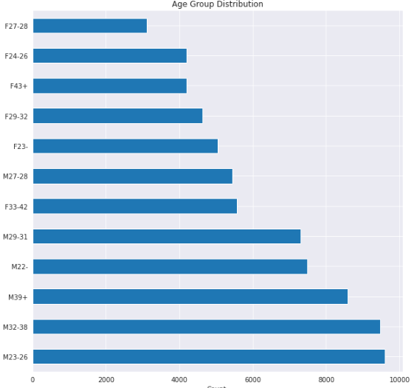
DATA EXPLORATION
Looking at the target data, we can see that the majority use base are males:
The majority are young adult males in their early 20s
We can see that there are less females in this data set but it could be that less female users use apps that TalkingData tracks.
Notes:
Moving from research question to some kind of hypothesis -- you want to use logic, theory and prior empirical evidence to move toward some hypotheses you can test. This is why domain expertise cannot be overlooked among data scientists.

Slide 7
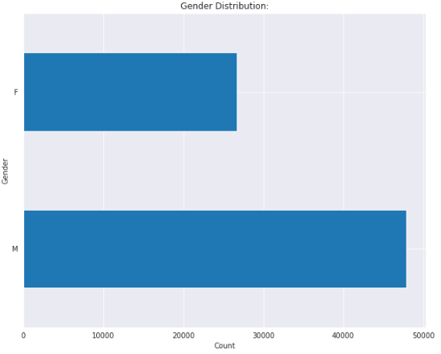
DATA EXPLORATION
Here we see that there are more guys than girls in this data set
There are almost double the amount of males than females
Notes:
Moving from research question to some kind of hypothesis -- you want to use logic, theory and prior empirical evidence to move toward some hypotheses you can test. This is why domain expertise cannot be overlooked among data scientists.

Slide 8
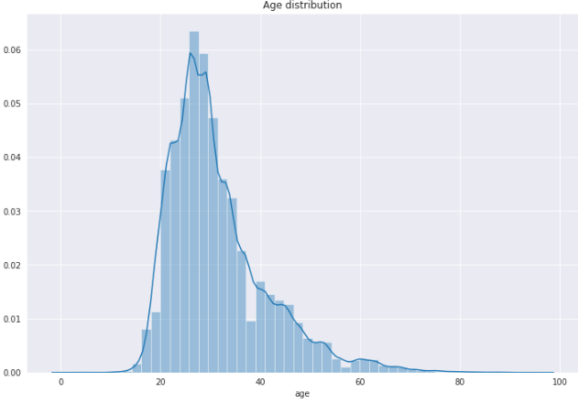
DATA EXPLORATION
We can see that the majority of the users are young adults from mid 20s to 30s.
There are less older adults users and it could be for a multitude of reasons.
Notes:
Moving from research question to some kind of hypothesis -- you want to use logic, theory and prior empirical evidence to move toward some hypotheses you can test. This is why domain expertise cannot be overlooked among data scientists.

Slide 9
DATA PRE-PROCESSING
6 separate csv files
Merge files based on “app_id” and/or “device_id” columns
Created dummies for the label_id (label of app) in order to create more features
After creating the dummies and merging the files, the data frame has approximately 7,034,111,494 records
Ended up down sampling the data set into 50,000 rows for each class of data in the group to fix the class imbalance (12 classes in the target data set)
Notes:
Moving from research question to some kind of hypothesis -- you want to use logic, theory and prior empirical evidence to move toward some hypotheses you can test. This is why domain expertise cannot be overlooked among data scientists.

Slide 10
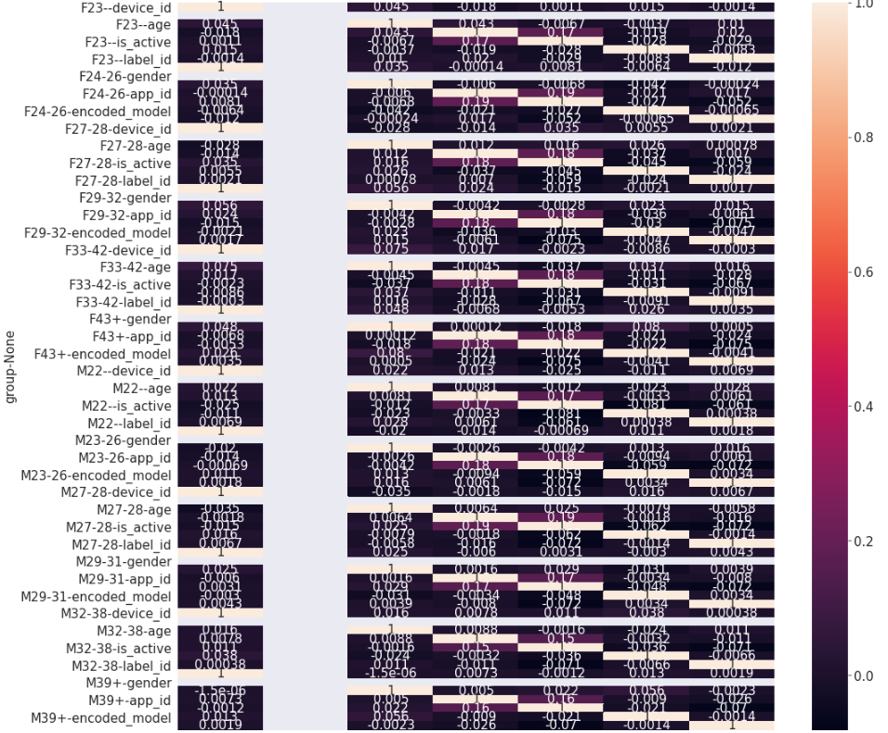
DATA TUNE UP
Made a heat map to see if there was any multi-collinearity present.
Faced another problem of having low to negative multi-collinearity instead.
Performed a train/test split with 25% holdout.
Notes:
Moving from research question to some kind of hypothesis -- you want to use logic, theory and prior empirical evidence to move toward some hypotheses you can test. This is why domain expertise cannot be overlooked among data scientists.

Slide 11
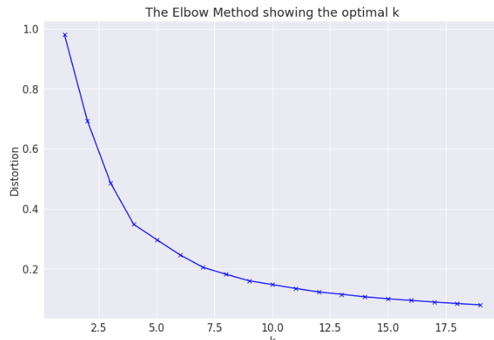
K-MEANS
Originally thought that 12 would be the optimal amount of clusters but the elbow method shows that approximately 5 clusters is the optimal amount.
Used k-means clustering to learn more about the data, but it was just an even distribution of data between the 5 clusters.
Notes:
Moving from research question to some kind of hypothesis -- you want to use logic, theory and prior empirical evidence to move toward some hypotheses you can test. This is why domain expertise cannot be overlooked among data scientists.

Slide 12
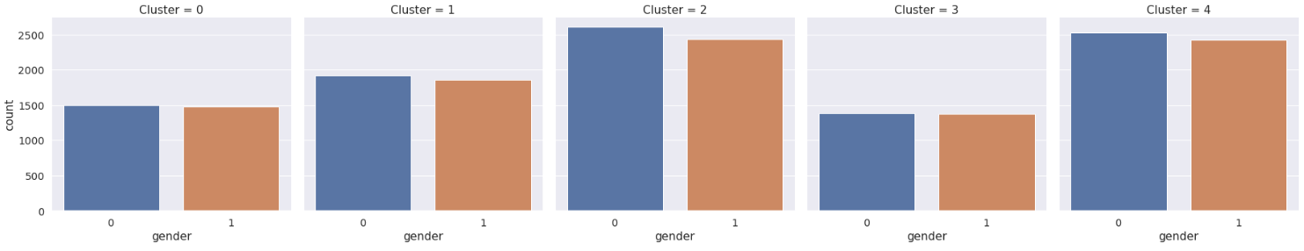
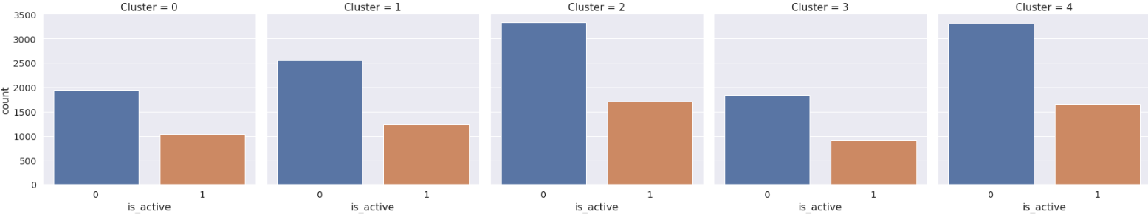
K MEANS CLUSTER DISTRIBUTION
As we can see here, the clusters look quite similar, and the data points are almost evenly distributed throughout the clusters without any one cluster having an overwhelming majority.
Notes:
A statistical method is not a story, but we can tell a story from the statistics. For example, using confidence intervals we can put into dollars what we think would happen if we make some business move, given the data that we have.
The words “t-test,” “normality,” “independent samples” etc did not come up at all in this explanation! Although someone who does know about this stuff can still have confidence in the results with the way you have laid out the story and the quantifiable results.

Slide 13
PERFORMANCE RUBRIC
Best Parameters: Parameters that allowed for the best classifying score.
Average 5-Fold Cross Validation Score – resampling the dataset into 5 equal sized samples and running through the models again.
Classification Report (Average scores between the different classes)
Precision – (TP/(TP+FP)) Ability of the classifier not to label as positive a sample that is negative.
Recall – (TP/TP+FN)) Ability to find all positive samples
F1- a weighted average of the precision and recall, where an F1 score reaches its best value at 1 and worst score at 0.
Notes:
A statistical method is not a story, but we can tell a story from the statistics. For example, using confidence intervals we can put into dollars what we think would happen if we make some business move, given the data that we have.
The words “t-test,” “normality,” “independent samples” etc did not come up at all in this explanation! Although someone who does know about this stuff can still have confidence in the results with the way you have laid out the story and the quantifiable results.

Slide 14
MODEL 1: LOGISTIC REGRESSION WITH PCA
Jumped right into PCA for this model due to the fact that I had low/negative multi-collinearity between my data.
GridSearchCV parameters: C:10,000, max_iter=200, multi_class:multinomial, solver:lbfgs
Used L-BFGS because it’s a more computationally efficient form of Newton’s method. Faster due to only using a few vectors to reconstruct the matrix.
Parameters: C:1000, max_iter:25, multi_class:multinomial, solver:lbfgs
Average of 92% accuracy.
Average Precision: 92% || Average Recall: 92% || Average F1: 92%
Notes:
A statistical method is not a story, but we can tell a story from the statistics. For example, using confidence intervals we can put into dollars what we think would happen if we make some business move, given the data that we have.
The words “t-test,” “normality,” “independent samples” etc did not come up at all in this explanation! Although someone who does know about this stuff can still have confidence in the results with the way you have laid out the story and the quantifiable results.

Slide 15
RANDOM FOREST (PCA)
Had more confidence in random forest without feature selection due to it being an ensemble model.
Best parameters: n_estimators:1000, max_features:8, max_depth:8
Average Accuracy: 94.03%
Average Precision: 93% || Average Recall: 93% || Average F1: 93%
PCA Best Parameters: n_estimators:800, max_features=6, max_depth=10
PCA Average Accuracy: 91.71%
PCA Average Precision: 90% || PCA Average Recall: 89% || PCA Average F1: 89%
Notes:
https://unsplash.com/photos/OX_en7CXMj4
Then we want to move to recommendations, what is the call to action? What should your audience do now that they know what you have told them?

Slide 16
X GRADIENT BOOSTED MODEL WITH PCA
Model was extremely overfitted even after instilling high regularization parameters and took a long time to run
Long computational time was also why I switched to XGB since it runs faster and reaches convergence faster than regular gradient boosting due to XGB employing stochastic gradient descent.
Employed PCA and used 10,000 rows of data
Parameters: max_depth: 5
Average of 93.29% accuracy
Average Precision: 90% || Average Recall: 90% || Average F1: 90%
Notes:
https://unsplash.com/photos/OX_en7CXMj4
Then we want to move to recommendations, what is the call to action? What should your audience do now that they know what you have told them?

Slide 17
NEURAL NETWORK: MULTILAYER PERCEPTRON MODEL WITH PCA
Used a Sequential model based on TensorFlow and Keras
Adam Optimizer, elu as the activation function.
8 layers, used batch normalization, 1250 batch size, 20 epochs.
Test accuracy: 98.33%
Notes:
https://unsplash.com/photos/OX_en7CXMj4
Then we want to move to recommendations, what is the call to action? What should your audience do now that they know what you have told them?

Slide 18
CONVOLUTIONAL NEURAL NETWORK (CNN) WITH PCA
Normally, CNN is used for image classification, but I wanted to see if I could use CNN on this 1D data set and see if I could obtain good results.
Had to increase the dimensional size of my training data, vectorize my target data before CNN would run.
3 convolutional layers, 6 dense layers, batch normalization, 1250 batch size, 10 epochs
Test accuracy: 70.84%
Notes:
https://unsplash.com/photos/OX_en7CXMj4
Then we want to move to recommendations, what is the call to action? What should your audience do now that they know what you have told them?

Slide 19
MOVING FORWARD & CHALLENGES
Try adding different models to see if there any other strong performing models with a decent run time.
Try using another optimizer for my neural network.
To make it work in a production like environment, we should set up the script in a server based (cloud or physical) environment and do some changes to capture the incoming data.
More Computing power would be a plus to analyze the entire dataset.
As far as challenge goes, Logistic Regression Model in particular crashed quite a few times, and I purchased additional RAM and set the RUN TIME accelerator to TPU to make it work. Even then, it failed a few times, and had to fine tune the parameters multiple times to achieve the desired results.
Notes:
https://unsplash.com/photos/OX_en7CXMj4
Then we want to move to recommendations, what is the call to action? What should your audience do now that they know what you have told them?

Slide 20
CONCLUSION
In terms of convenience in implementation, Random Forest, was the easiest model to run that performed the strongest with minimal parameter tuning. One would have to be careful of overfitting due to the volume of the data though.
Coming in second, Neural Network with PCA was a super strong performer that took only half the amount of time as the time needed for Random Forest.
Notes:
https://unsplash.com/photos/OX_en7CXMj4
Then we want to move to recommendations, what is the call to action? What should your audience do now that they know what you have told them?

Slide 21
Questions?

Slide 22
Thank You

